Slide 1
Clinical Decision Support System (CDSS)

Slide 2
What is Clinical Decision Support (CDS)?
Clinical decision support is a process for enhancing health-related decisions and actions with pertinent, organized, clinical knowledge, and patient information to improve health and healthcare delivery. Information recipients can include patients, clinicians, and others involved in patient care delivery; information delivered can include general clinical knowledge and guidance, intelligently processed patient data, or a mixture of both; and information delivery formats can be drawn from a rich palette of options that includes data and order entry facilitators, filtered data displays, reference information, alerts, and others.
Osheroff JA, Levick DL, Saldana L, Velasco FT, Sittig DF, Rogers KM, et al. Improving Outcomes with Clinical Decision Support: An Implementer’s Guide, 2nd ed., Healthcare Information and Management Systems Society, Chicago, IL; 2012

Slide 3
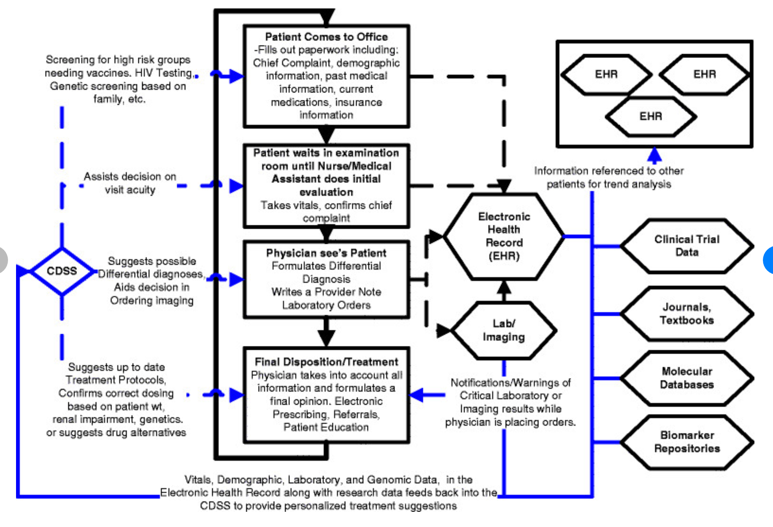
Workflow of a patient visit

Slide 4
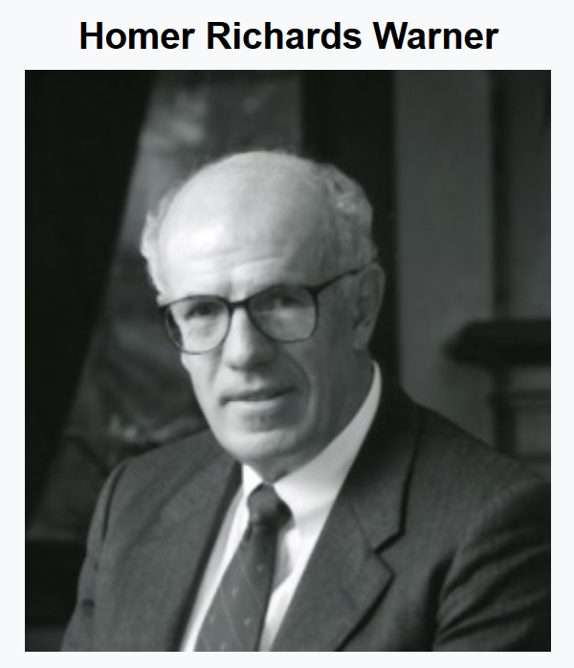
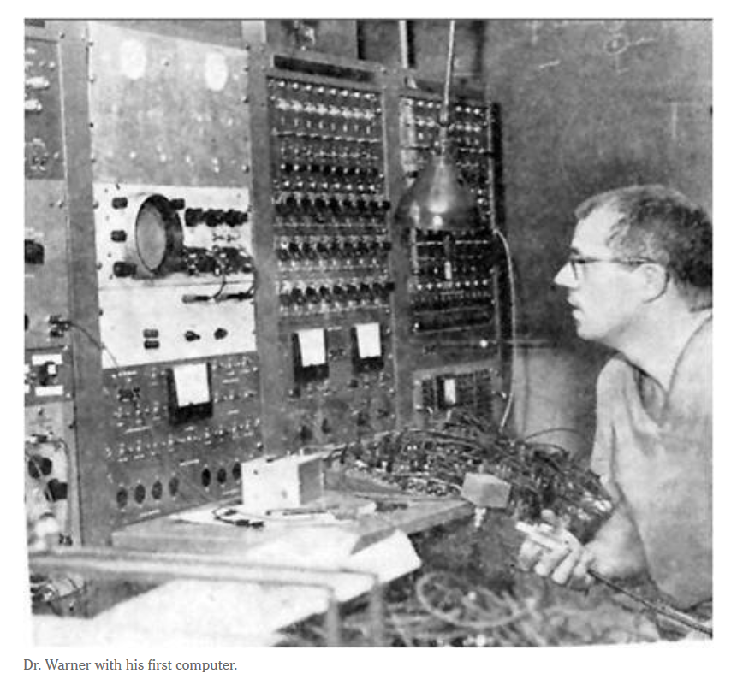
Pioneer of CDS
Dr. Warner was a cardiologist from University of Utah and the first doctor to use computer to facilitate clinical decision making.
He developed a mathematical model to diagnose heart disease.
Homer R. Warner award
It includes a $1000 prize, and is presented each year at the American Medical Informatics Association (AMIA). It is named for Warner. It is awarded for the paper that best describes approaches to improving computerized information acquisition, knowledge data acquisition and management, and experimental results documenting the value of these approaches.

Slide 5
CDSS
CDSS is an application that analyzes data to help healthcare providers make decisions and improve patient care.
A CDSS focuses on using knowledge management to get clinical advice based on multiple factors of patient-related data.
It enables integrated workflows, provides assistance at the time of care and offer care plan recommendations.
The purpose of CDSS is to assist healthcare providers, enabling an analysis of patient data and using that information to aid in formulating a diagnosis.
It offers information and insights to clinicians and primary care providers to improve the quality of care
It can lower costs and increase efficiency

Slide 6
CDSS usage
CDSS can apply machine learning and deep learning methods to examine a patient’s medical history in conjunction with relevant clinical research.
The results can be used to predict future events, such as drug interactions, or flag disease symptoms.
It offers reminders for preventive care, gives alerts about potential dangerous drug interactions, alerts clinicians to possible redundant testing
It can be used to flag patients who were improperly diagnosed or either missed or given the wrong dosage of medication

Slide 7
HITECH Act
Health Information Technology for Economic and Clinical Health Act (HITECH Act) stipulates that providers had to demonstrate the meaningful use of health IT by 2015 or face a reduction in Medicare reimbursements the following year.
Under meaningful use, providers must implement one clinical decision support rule, including diagnostic test ordering and the ability to track compliance with that rule.

Slide 8
Meaningful Use: 13 Core Objectives
Computerized provider order entry (CPOE)
Drug-drug and drug-allergy checks
Maintain an up-to-date problem list of current and active diagnoses
E-Prescribing (eRx)
Maintain active medication list
Maintain active medication allergy list
Record demographics
Record and chart changes in vital signs
Record smoking status for patients 13 years or older
Implement clinical decision support
Provide patients with the ability to view, download, or transmit their health information online
Provide clinical summaries for patients for each office visit
Protect electronic health information
Notes:
http://www.cms.gov/Regulations-and-Guidance/Legislation/EHRIncentivePrograms/Downloads/EHR_Medicaid_BegGuide_Stage1.pdf

Slide 9
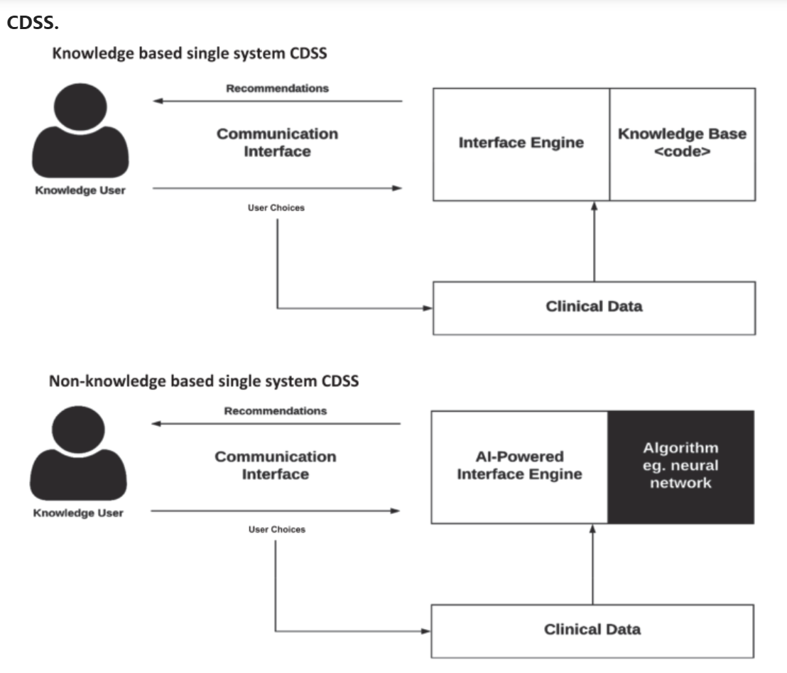
CDSS: Knowledge-based or not
There are two main types of CDSS
Knowledge based (expert system): applies rules to patient data using an inference engine and displays the results. Most of the rules are if-then rules. Example:
If drug A is taken and drug B is prescribed, then an alert should be issued.
Non-Knowledge based system:
ML/DL/AI
Data and algorithm driven
https://www.nature.com/articles/s41746-020-0221-y

Slide 10
Knowledge based systems
Functions
Alerts and reminders
Diagnostic assistance
Therapy critiquing and planning
Prescribing decision support systems
Information retrieval
Image recognition and interpretation
Contain clinical knowledge, specially defined task, and are able to give reasons with data from individual patients
Form a set of rules

Slide 11
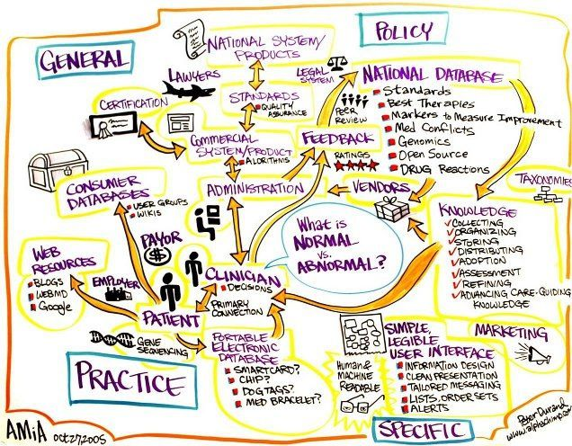
CDSS components
Encompassing a variety of tools to enhance decision-making in the clinical workflow. These tools include:
computerized alerts and reminders to care providers and patients
clinical guidelines
condition-specific order sets
focused patient data reports and summaries
documentation templates
diagnostic support
contextually relevant reference information among other tools.

Slide 12
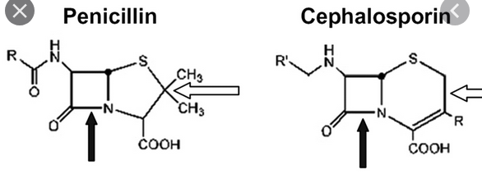
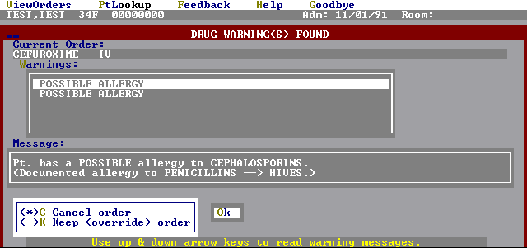
Alerts and reminders
Real-time situations
Can warn changes in patient’s condition
Might scan laboratory test results, drug or test order, or the EMR
Send reminder or warnings, either immediate on screen feedback or via email
Reminds to notify clinicians of important tasks to follow.

Slide 13
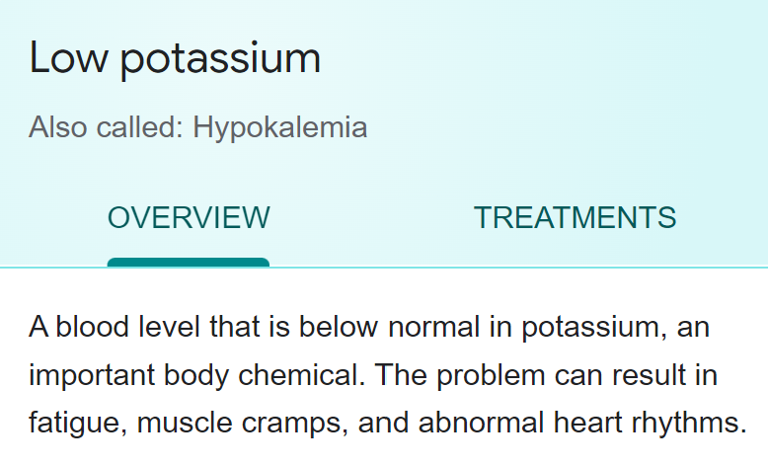
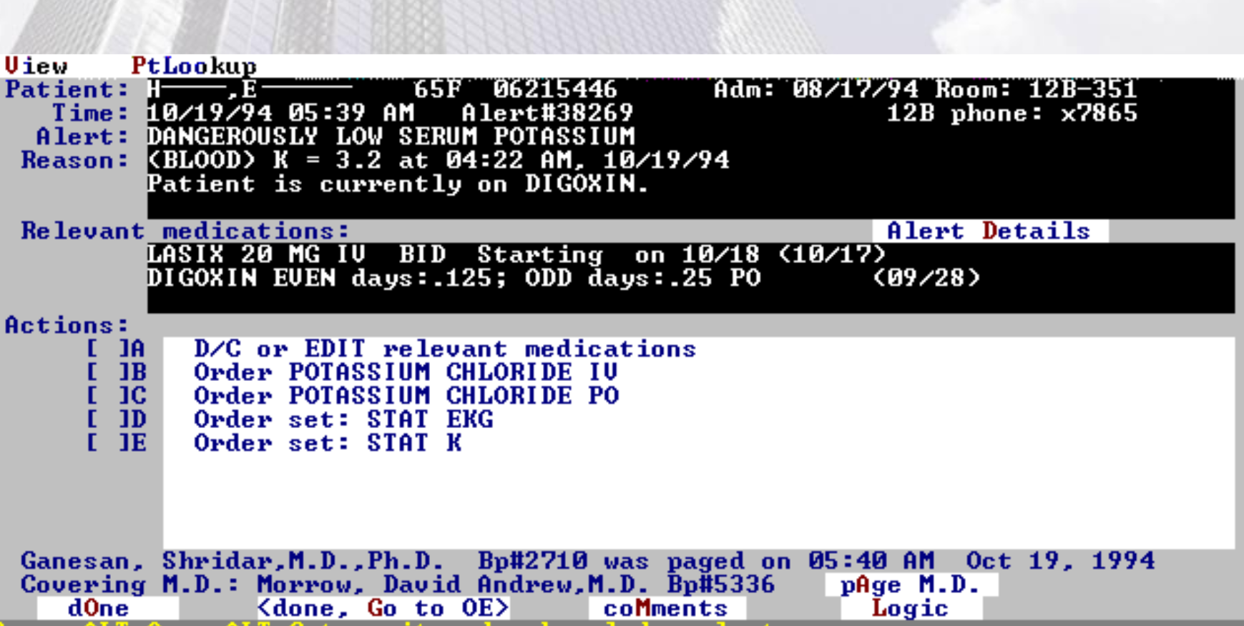
Response to abnormal lab results

Slide 14
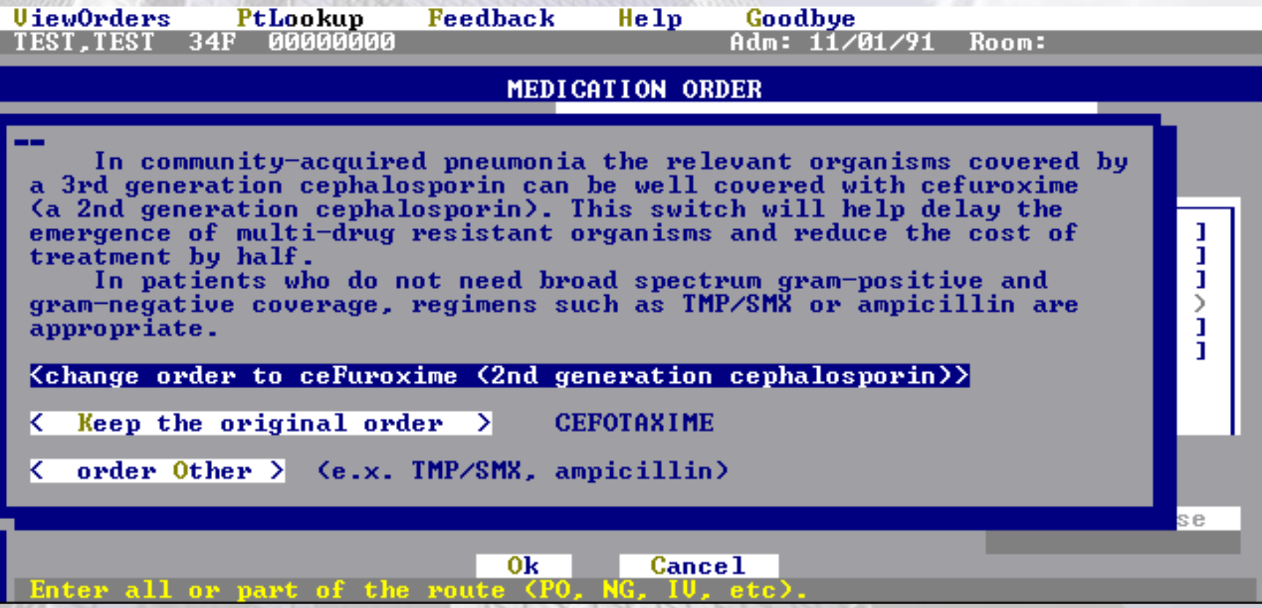
Drug prescription critique

Slide 15
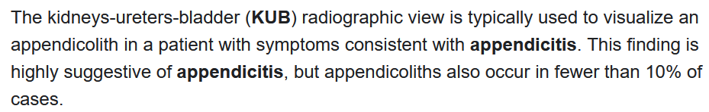
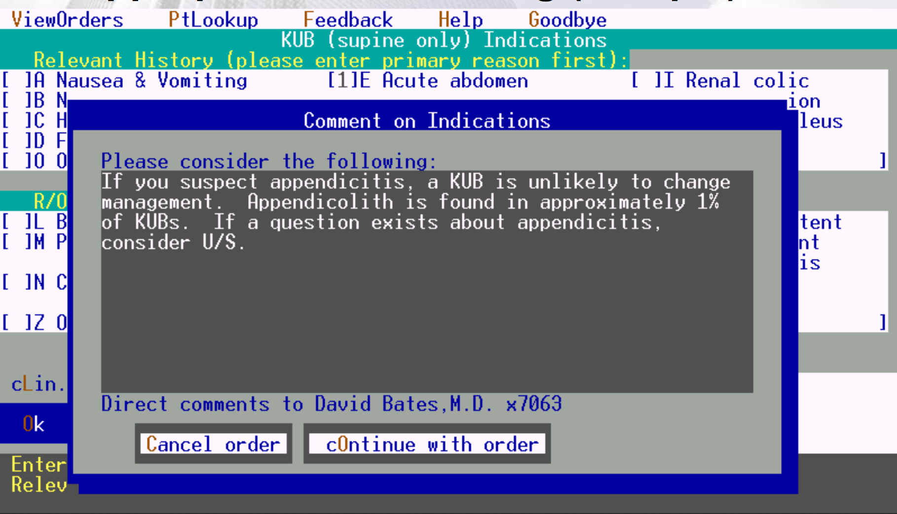
Appropriate test ordering
U/S is ultrasound

Slide 16
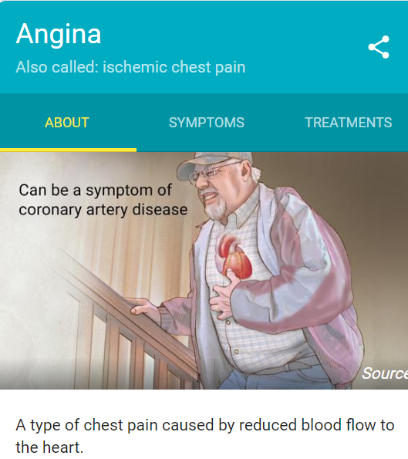
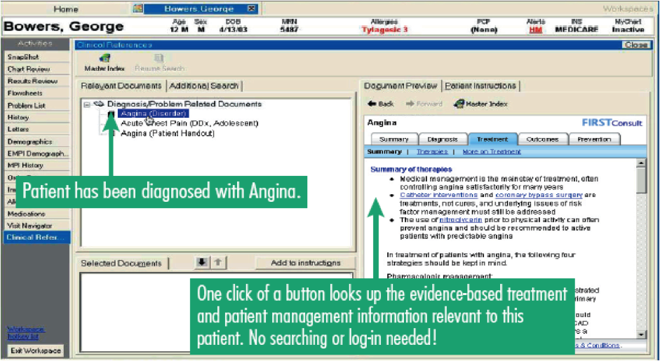
Provide reference

Slide 17
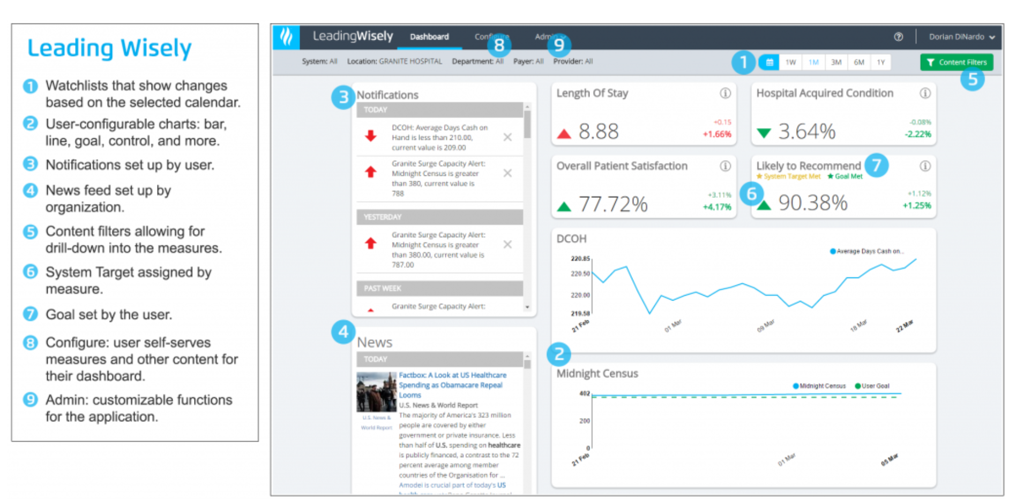
Dashboard

Slide 18
Examples of The Value of CDSS
Quality
By guiding users to best practices
Safety
By verifying an action was the intended one
Cost
Catching duplicate or unnecessary orders
Documentation
By bringing forth documentation tools based on a diagnosis or problem
Communication
Of system priorities or initiatives
Among providers of patient status

Slide 19
Mechanism of CDSS: SNOMED CT Concept Model
Concept
Identified by a unique SNOMED CT Concept Identifier
195967001- Asthma
Human-readable descriptions for each concept
Relationships
is-a relationship (relates a concept to a parent or supertype) define the hierarchy of concepts
Bacterial pneumonia and Viral pneumonia both have an is-a relationship to Infective pneumonia
Additional attributes
Viral pneumonia has a Causative agent relationship to the concept Virus.
Description Logic
DL reasoned: reasoning
Testing expressions for subsumption and equivalence.
If a rule will be triggered by Asthma, it will be triggered if it is Acute asthma.

Slide 20
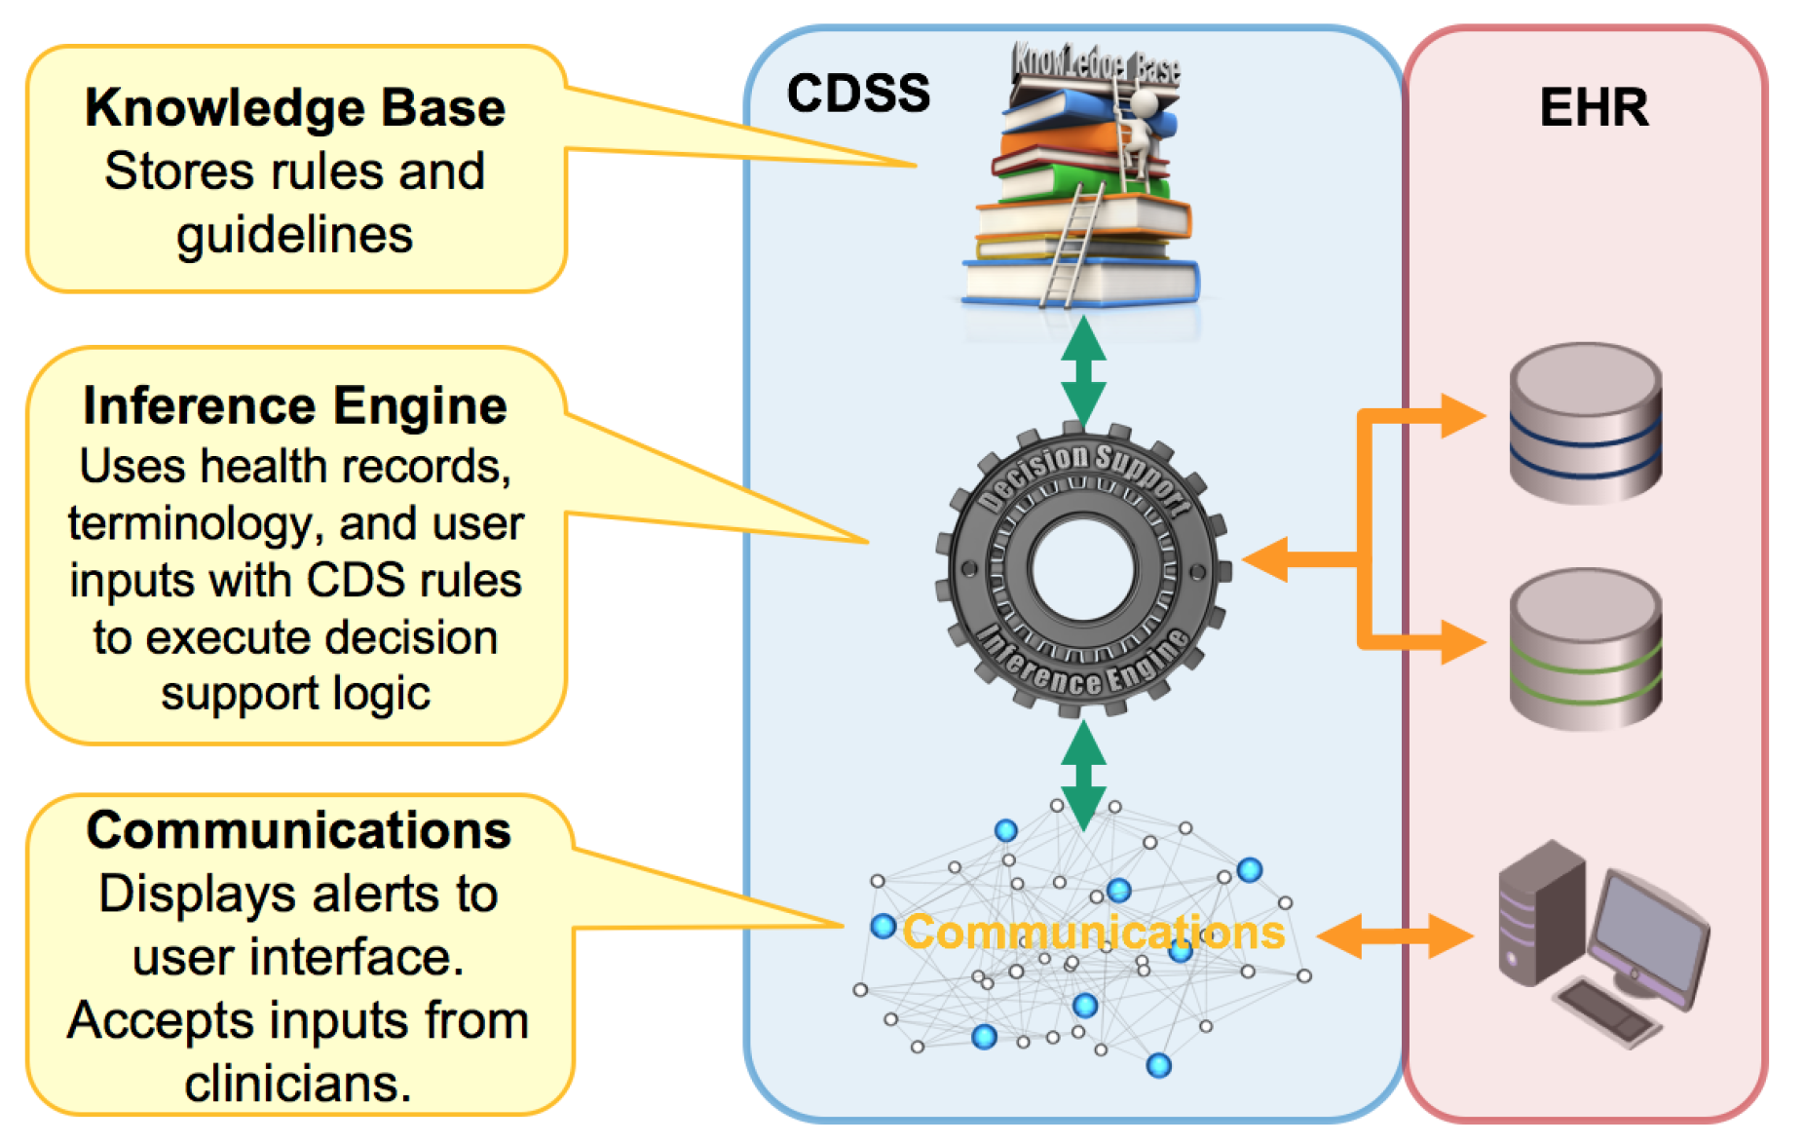
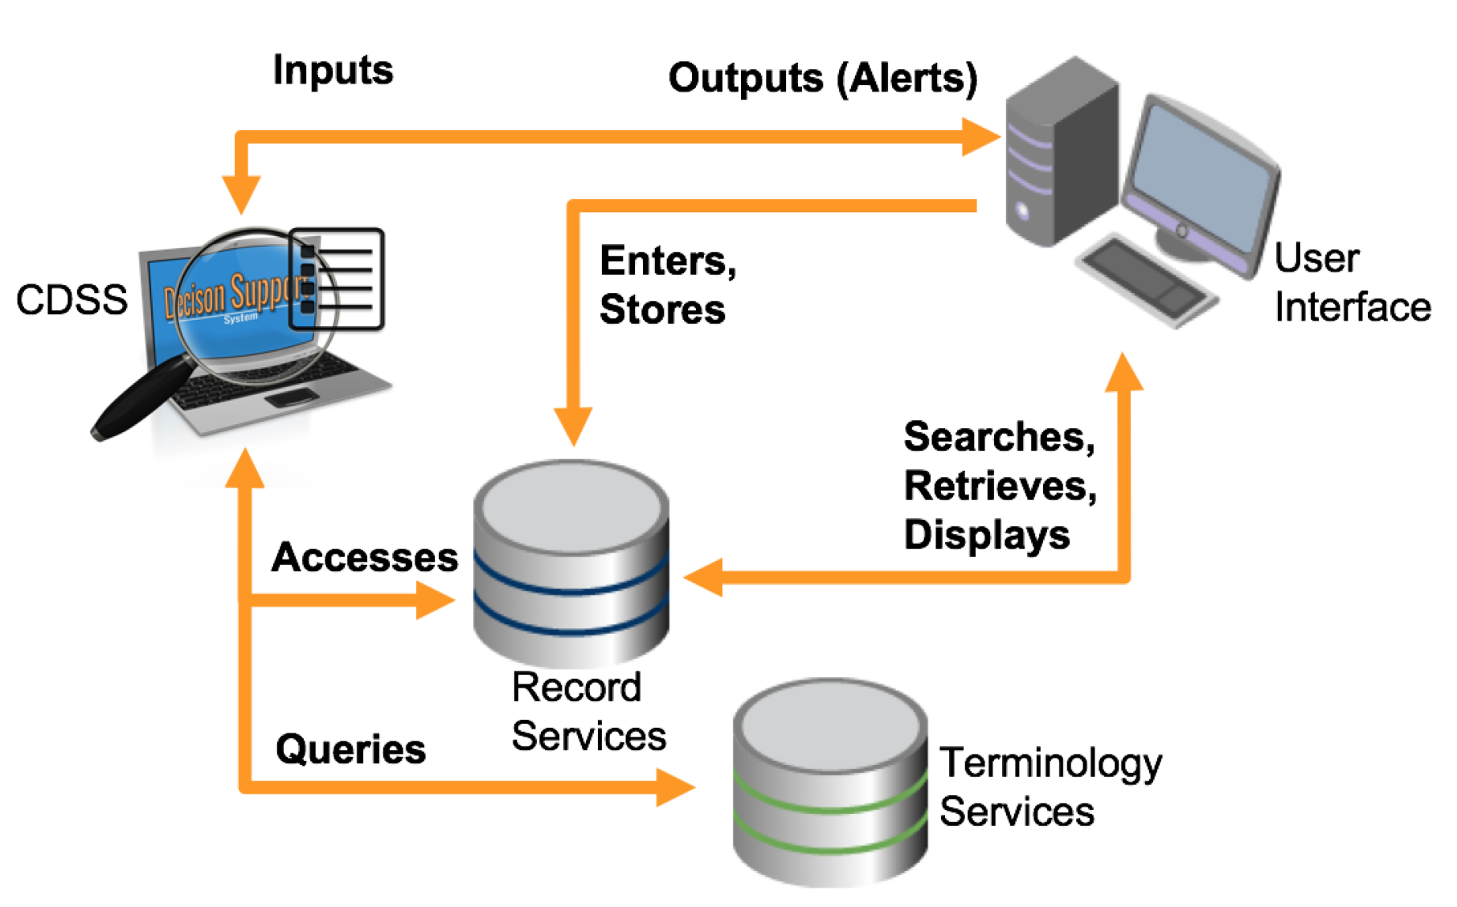

Slide 21
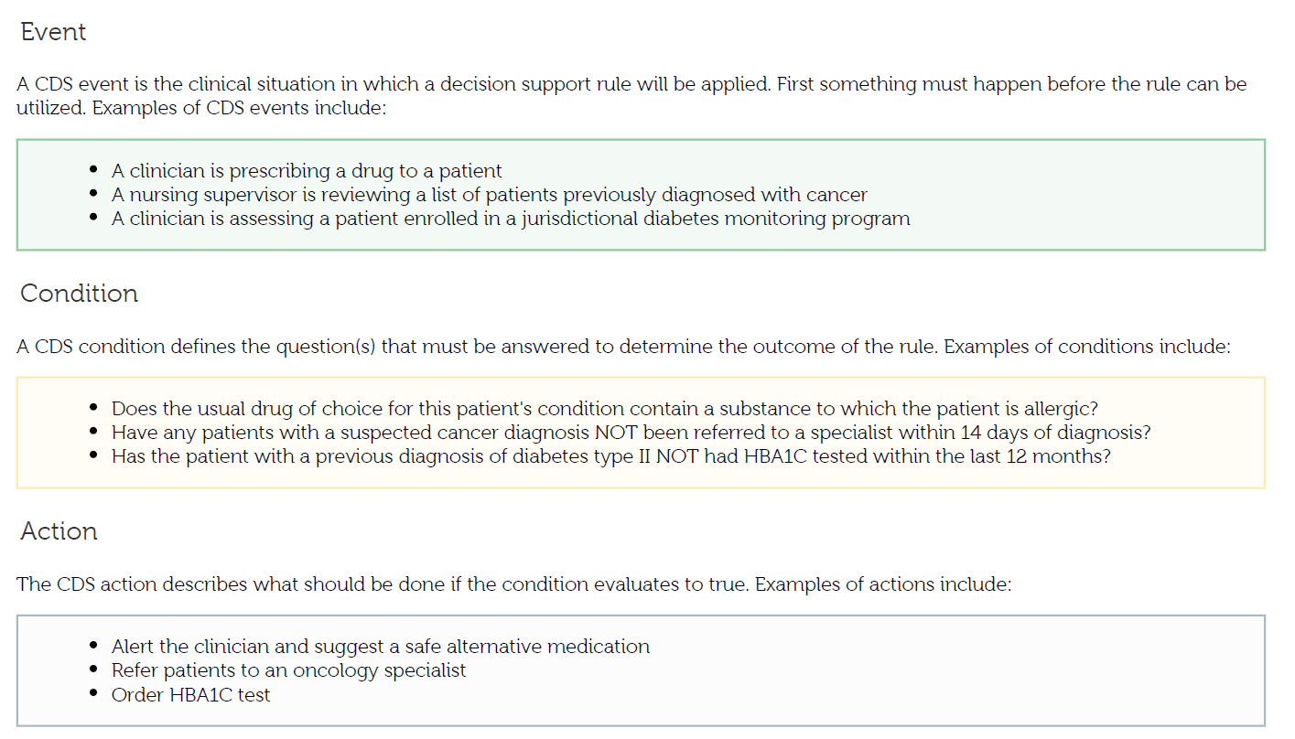
Rules

Slide 22
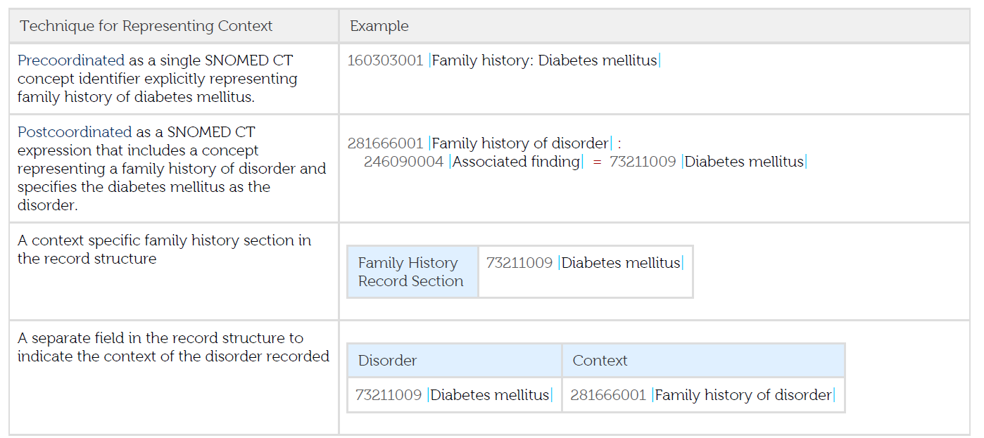
Context in Rules

Slide 23
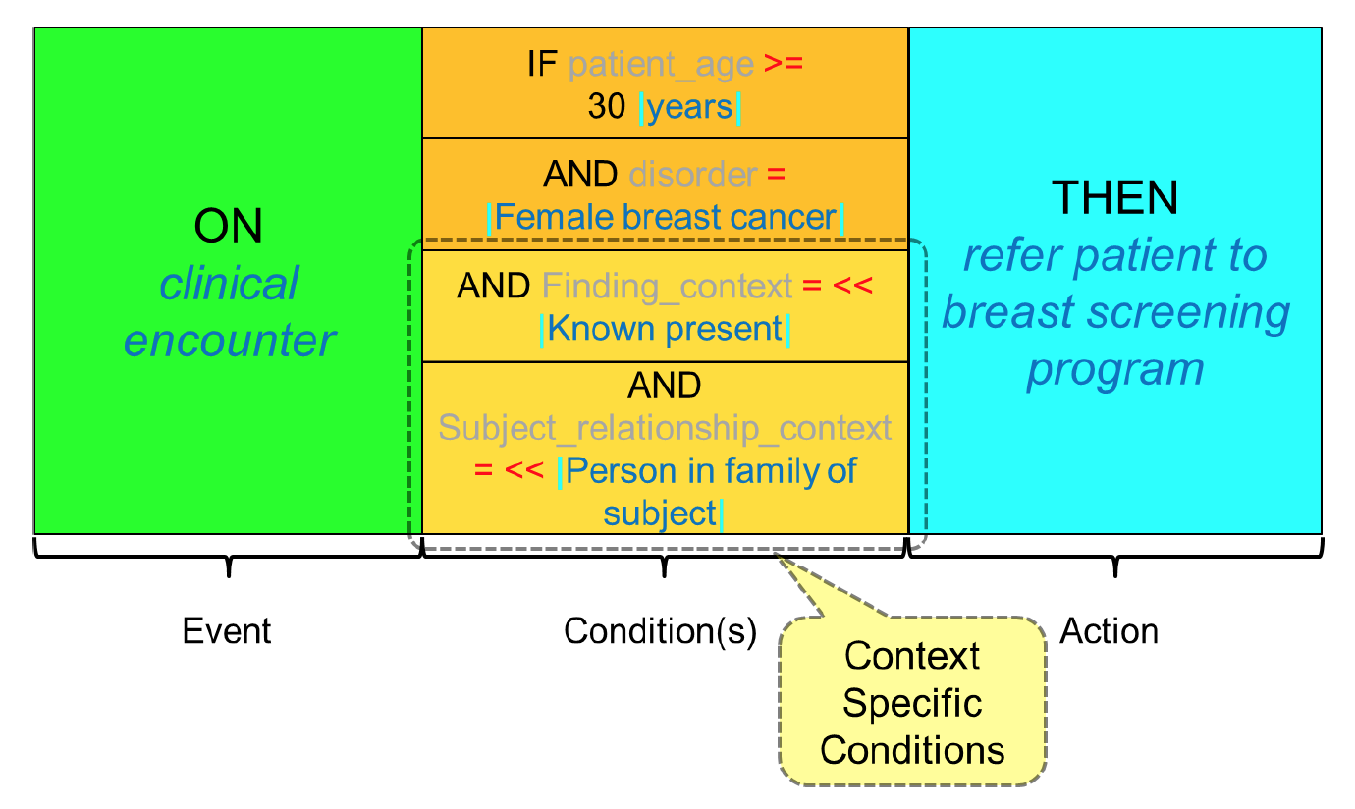
Context in a rule

Slide 24
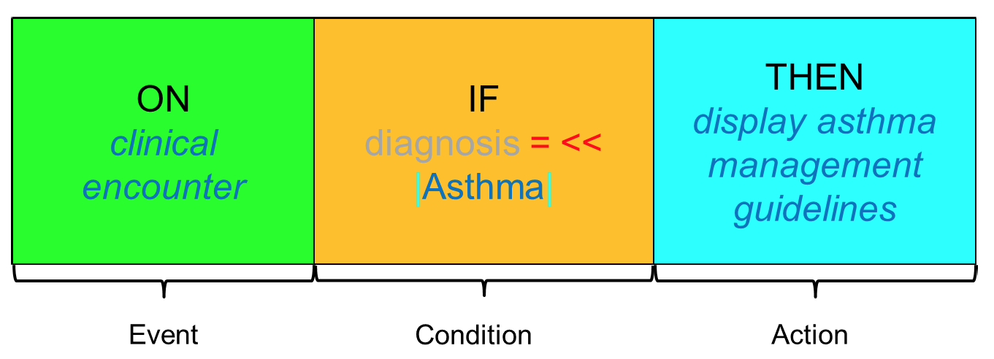
Rules and actions

Slide 25
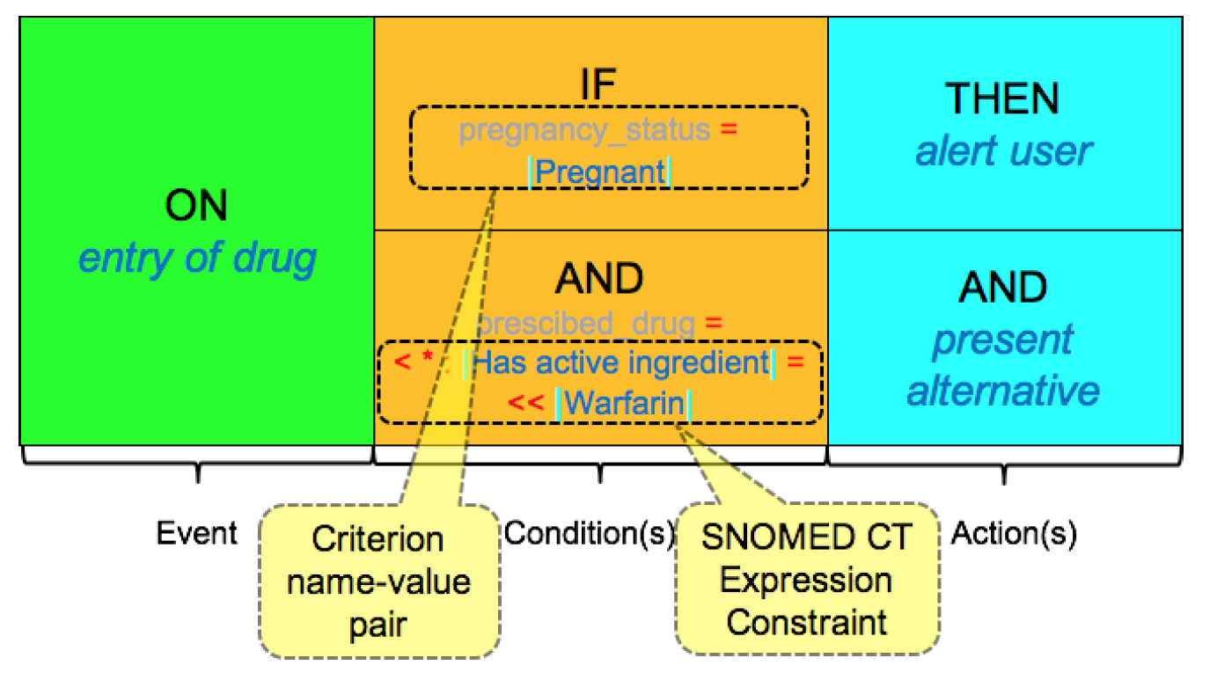
Rules and actions

Slide 26
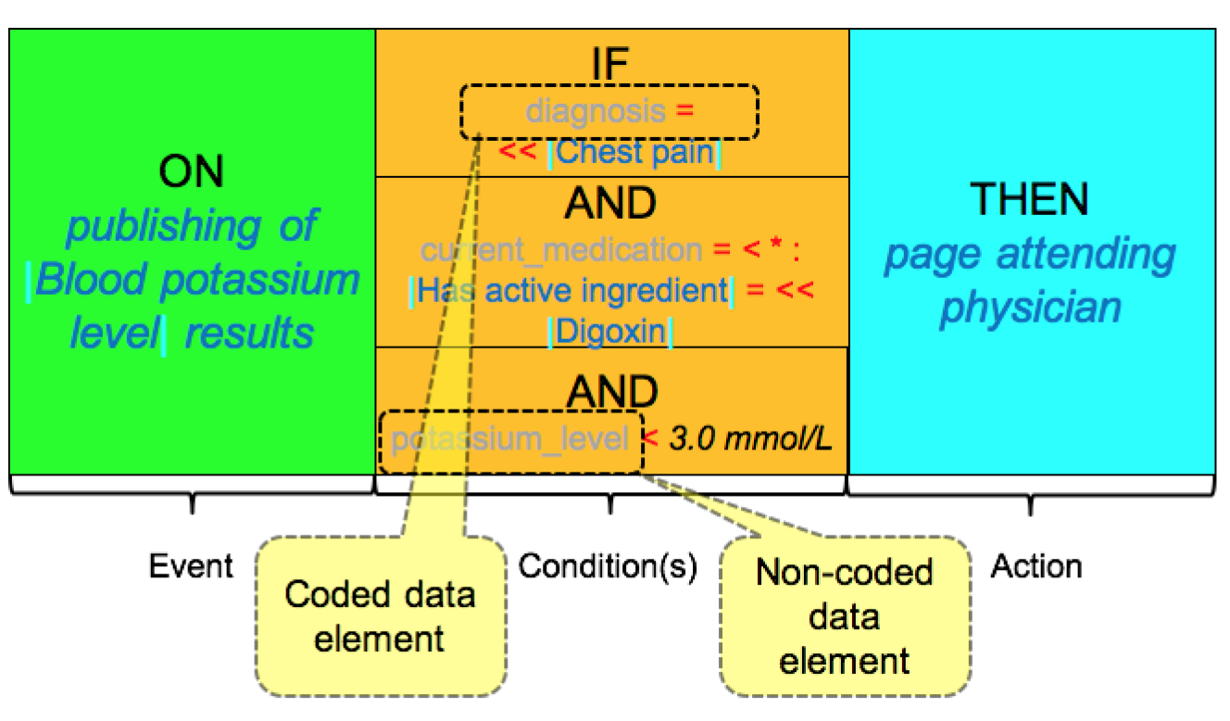
Rules and actions

Slide 27
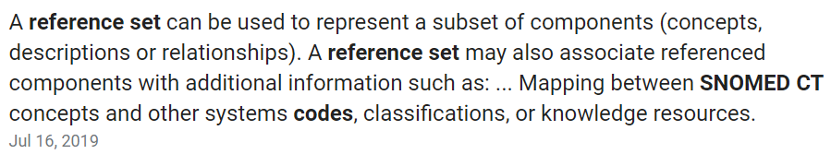
Clinical Guidelines and SNOMED CT
Clinical guidelines can be linked to SNOMED CT to enable the automated display of contextually relevant knowledge resources.
A guideline can be linked to a SNOMED CT concept using semantic tags
SNOMED CT concepts an be associated with guidelines using a reference set.
Automated display of a contextually relevant guideline based on the selection of a SNOMED CT concept in a data entry protocol.

Slide 28
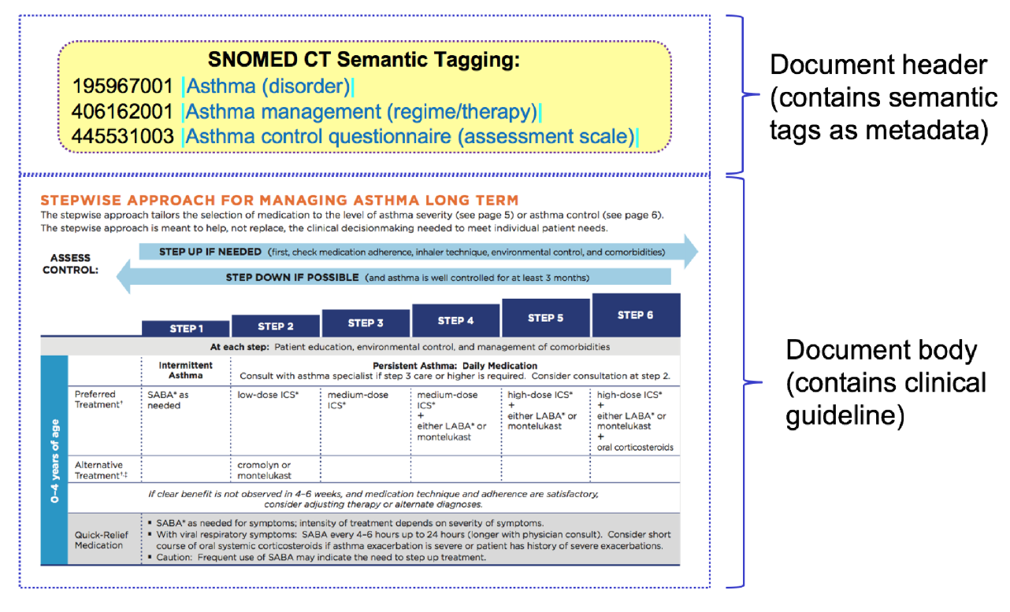
Smart Tag

Slide 29
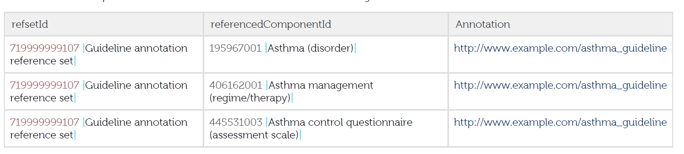
Reference Set

Slide 30
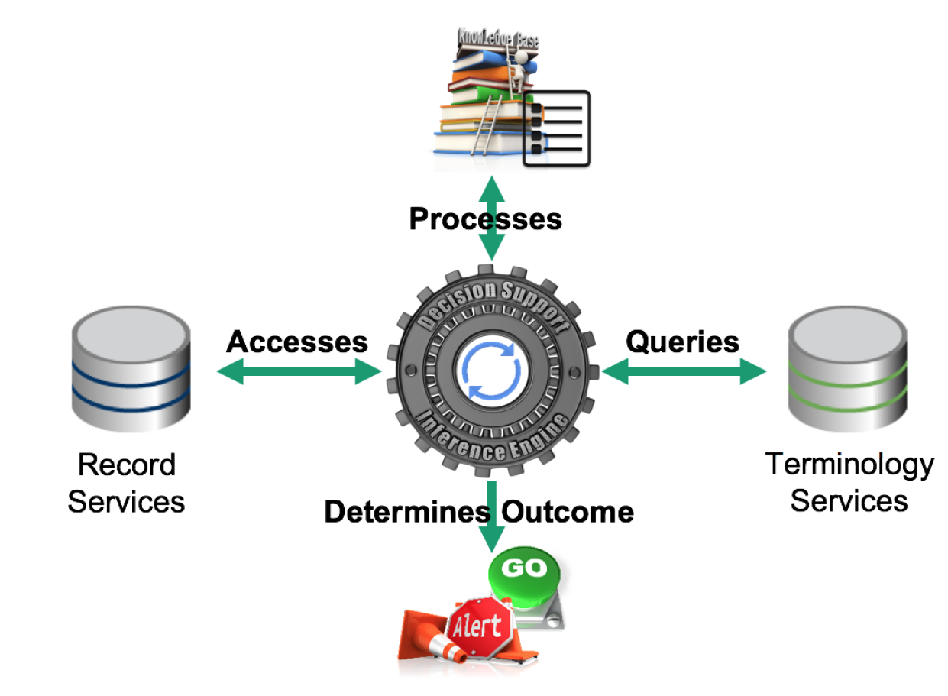
Inference

Slide 31
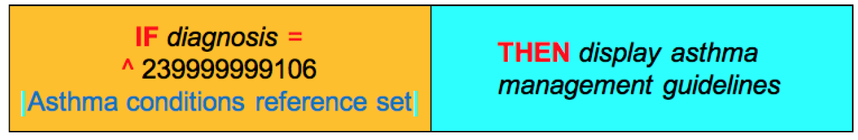
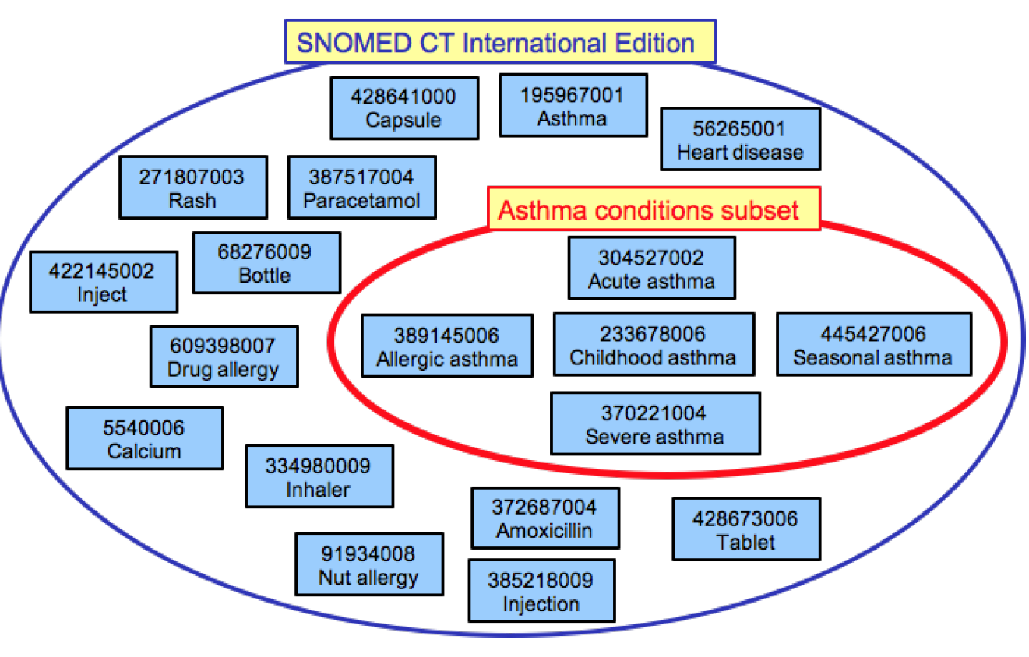
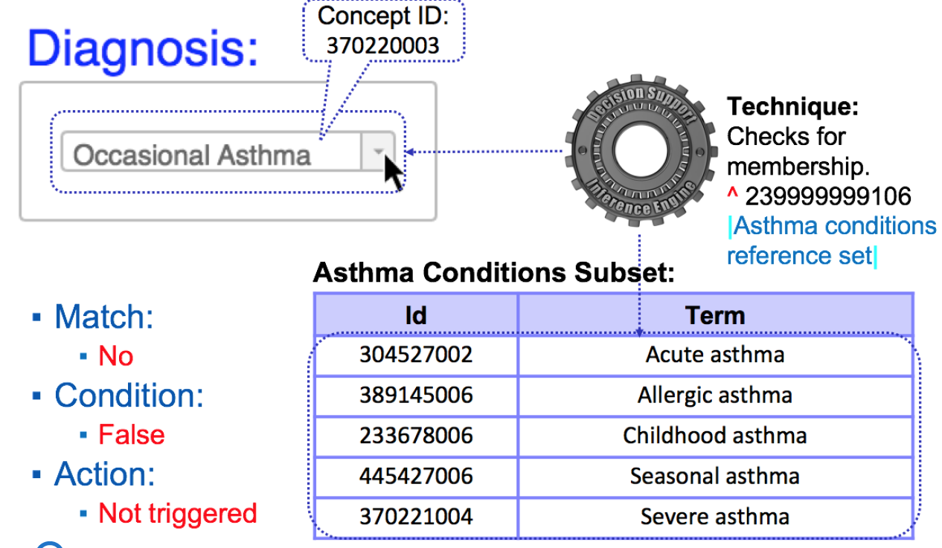
Subset

Slide 32
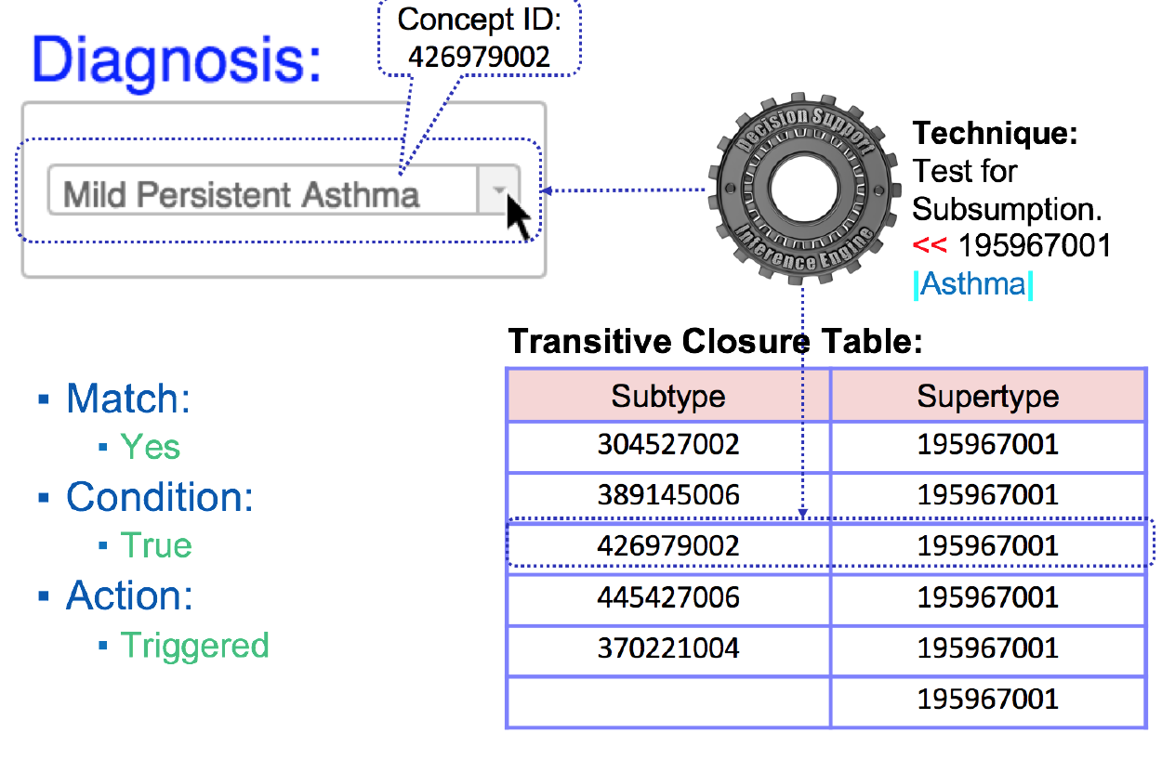
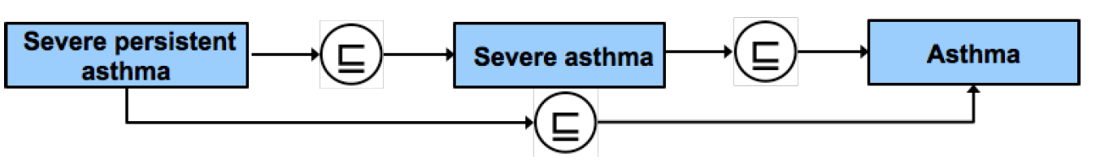
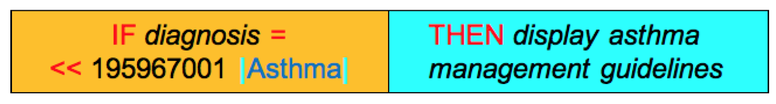
Subsumption

Slide 33
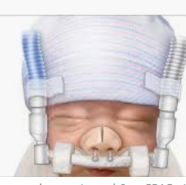
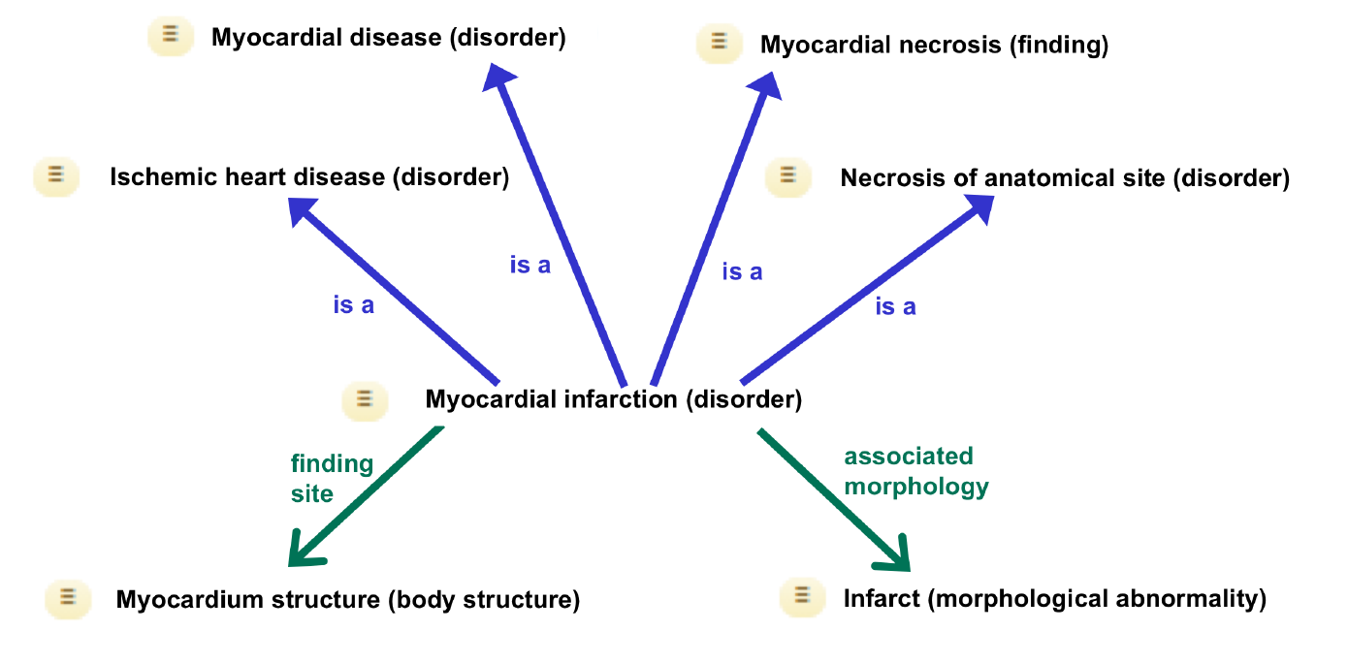
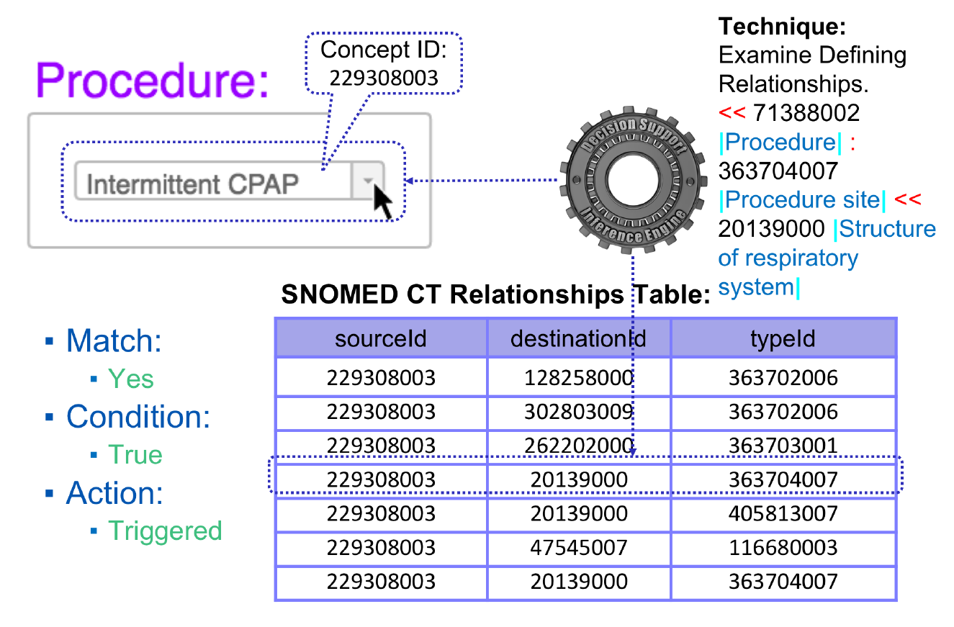
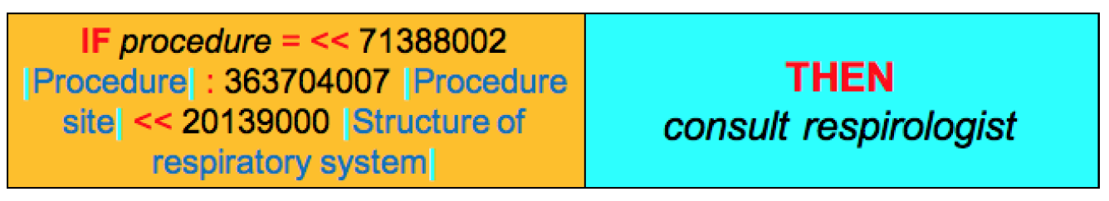
Relationship

Slide 34
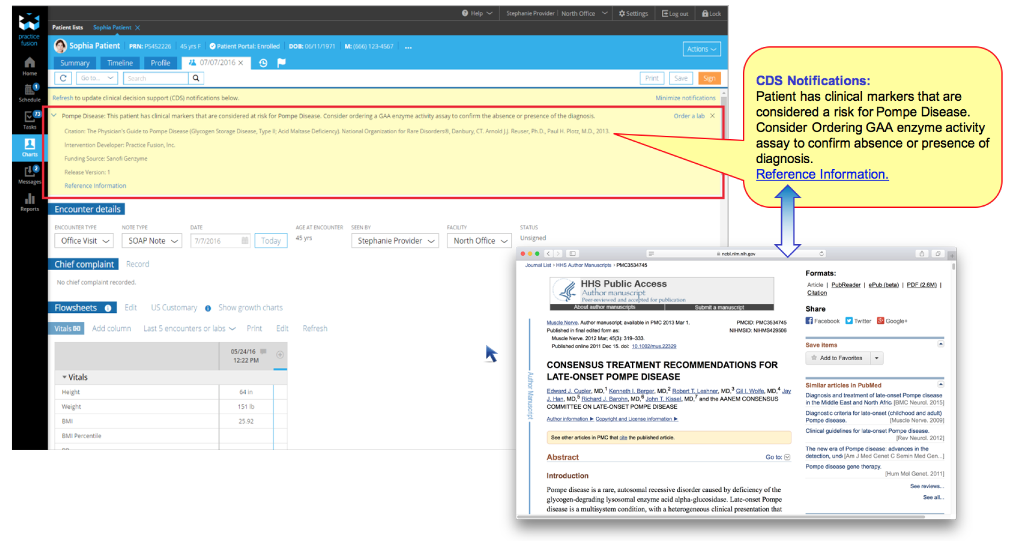
Communication

Slide 35
Reference
Sutton, R.T., Pincock, D., Baumgart, D.C. et al. An overview of clinical decision support systems: benefits, risks, and strategies for success. npj Digit. Med. 3, 17 (2020). https://doi.org/10.1038/s41746-020-0221-y

